Slide 1


SQL CASE STUDY
VALENTINE'S DAY CHOCOLATE SALES
@bandyopadhyay-ankan

Slide 2

CHALLENGE: TO CRAFT SQL QUERIES TO EXTRACT INSIGHTS FROM THE TOTAL CHOCOLATE SALES ON VALENTINE'S DAY
TABLES
COUNTRIES
PRODUCTS
SALES

Slide 3
QUESTIONS
1)FIND THE PRODUCT WITH THE HIGHEST AVERAGE REVENUE PER SALE?
2)FIND THE PRODUCT WITH THE HIGHEST TOTAL REVENUE?
3)DETERMINE THE MONTH WITH THE HIGHEST TOTAL REVENUE ACROSS ALL SALES?

Slide 4

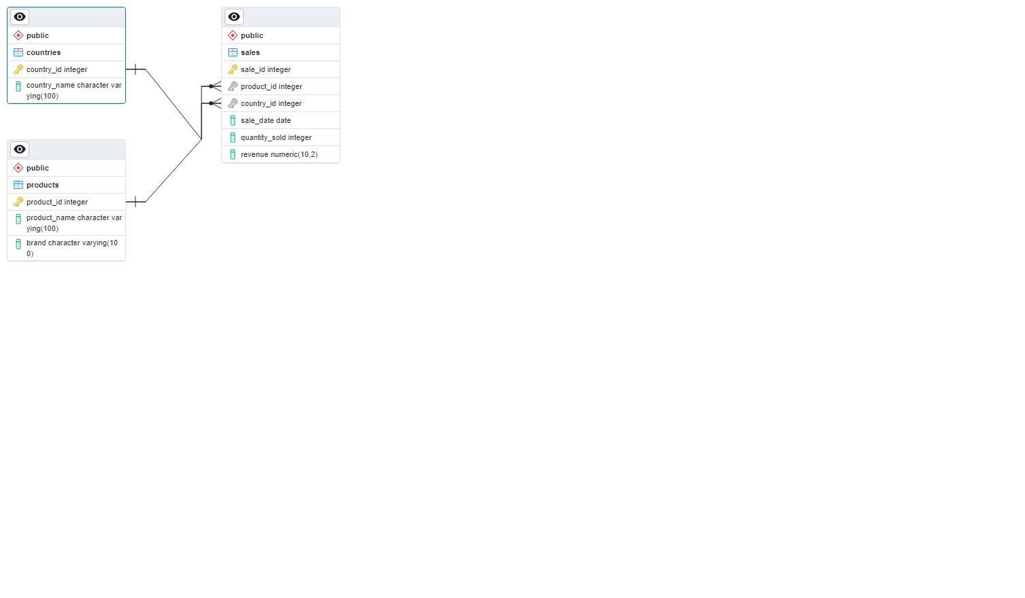
ERD:

Slide 5

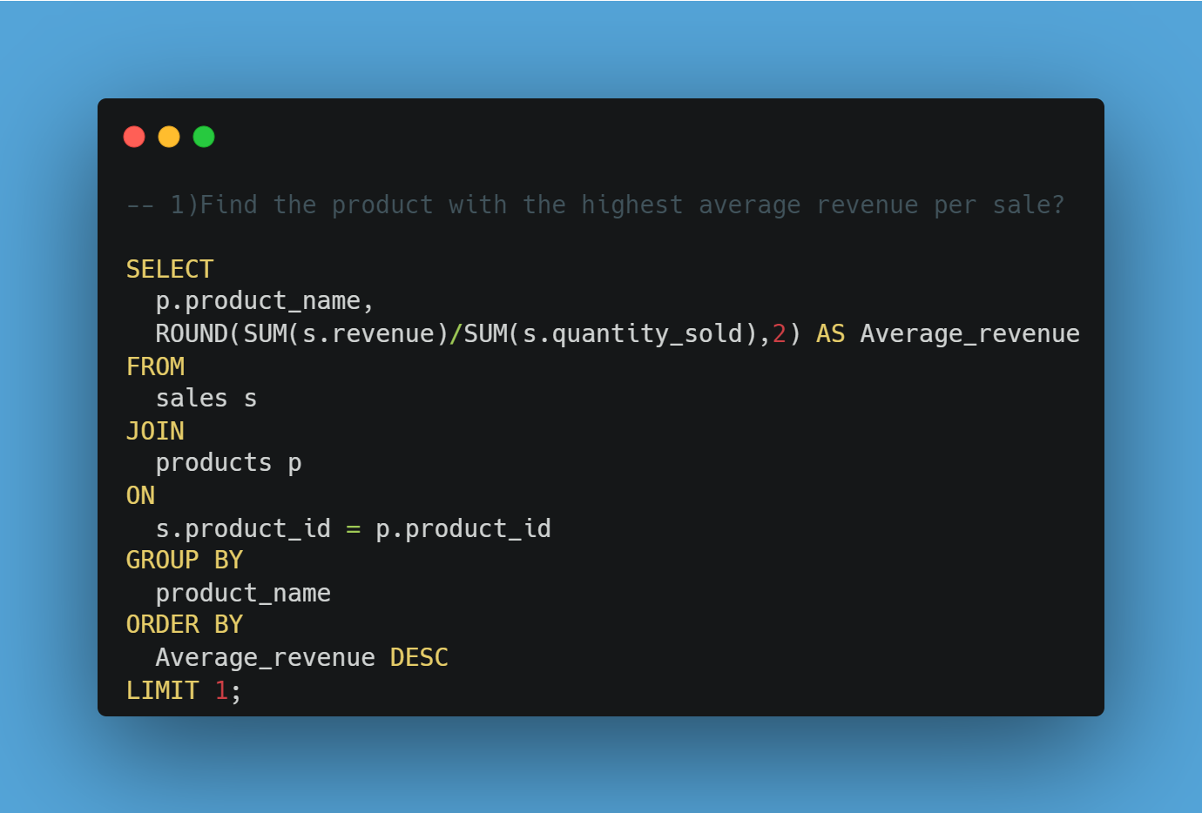

Slide 6

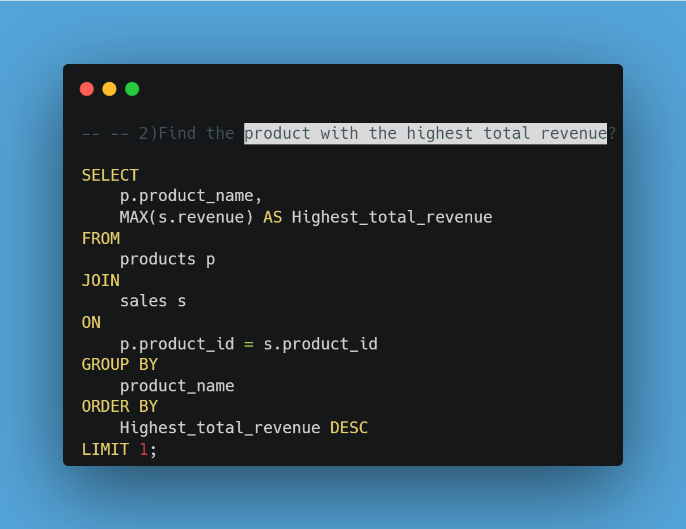

Slide 7

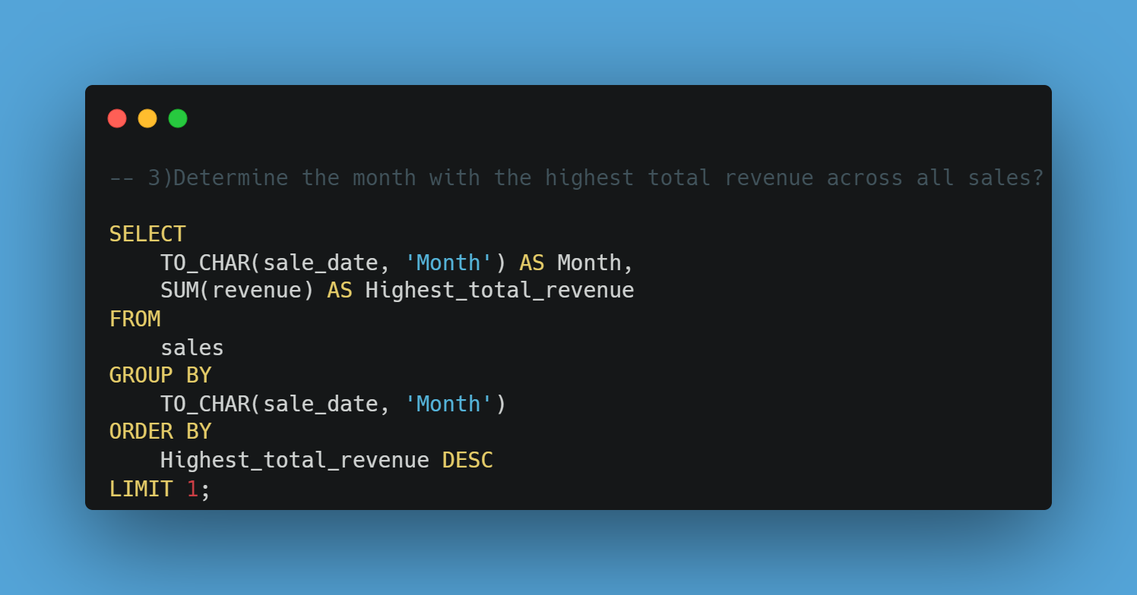

Slide 8

THANK
YOU

